Slide 1
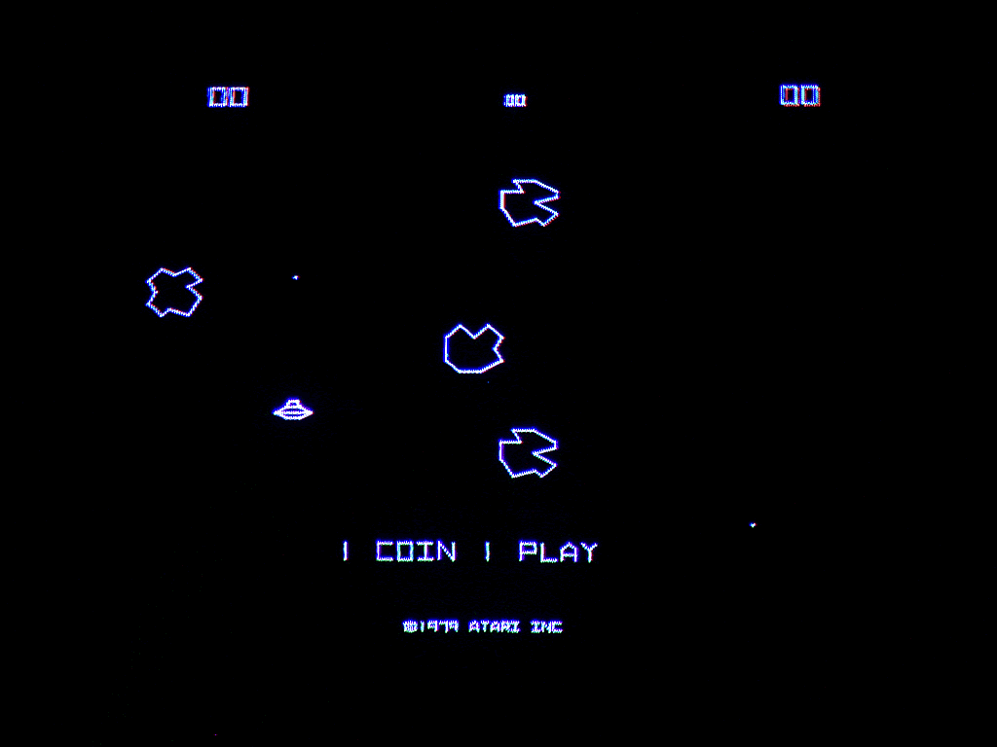

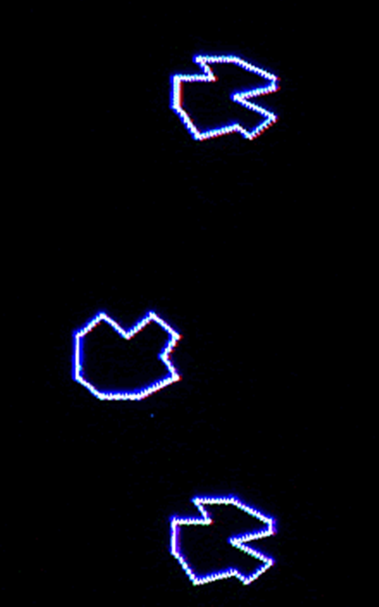


Transfer Learning with Features as Distributions
Transfer Learning with Features as Distributions
Paul Blankley
18 JANUARY 2018

Slide 2
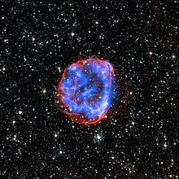
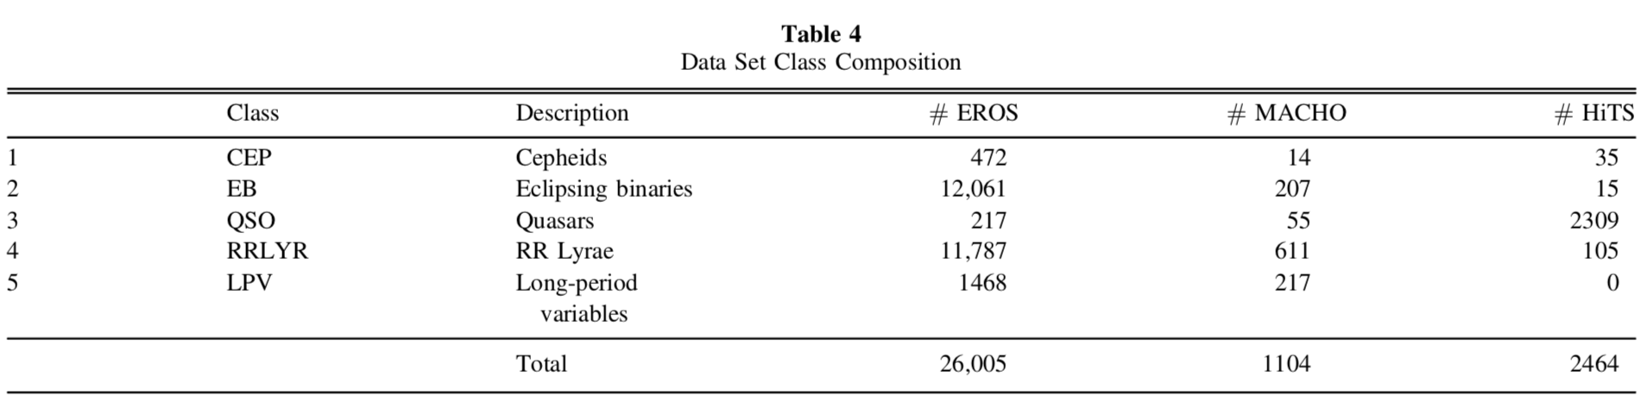
TRANSFER LEARNING
Why transfer learning?
Make classifications on datasets with very few observations by training on larger datasets.
Source: Wikipedia
Source: [1]

Slide 3
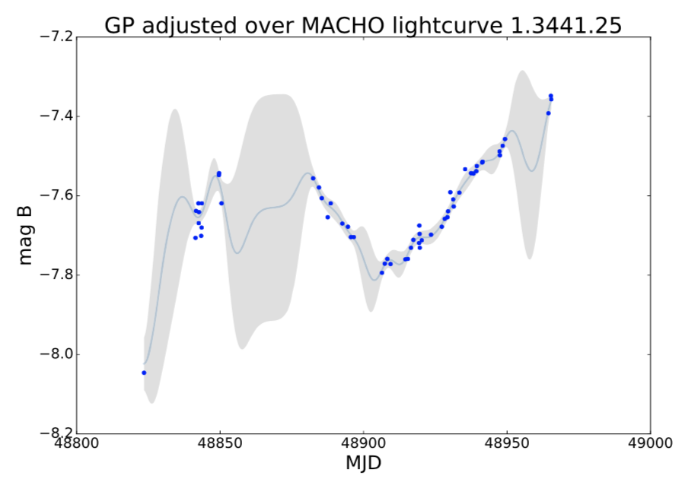
FEATURES AS DISTRIBUTIONS
Why treat features as distributions?
Make explicit both measurement error and error from gaps in the time series.
Source: [2]

Slide 4
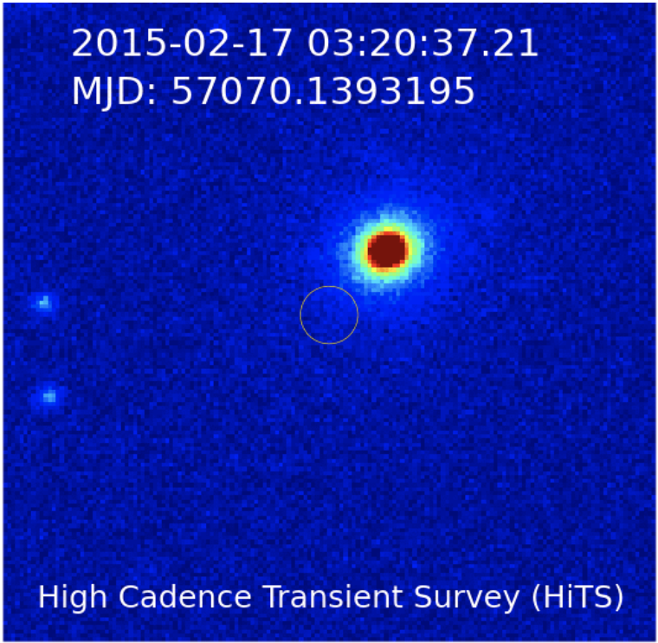
A HARD PROBLEM…
Example of an observation in HiTS
The HiTS survey varies greatly from EROS and MACHO
This, with the difference in distributions makes naïve model transfer inadequate ^{[1]}
There is also potential error and gaps in the features
Ignoring error and gaps in the features is undesirable because error-aware models have shown performance gains^{[2]}
Source: [3]

Slide 5
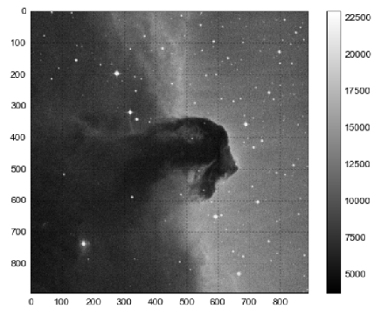
PROPOSED DIRECTION
LEARNING DOMAIN ADAPTATION
Train the model, use domain adaptation^{[1]} to transform data and continue training or freeze coefficients and train last layer
In domain adaptation^{[1]}, learn the transformation then train the model entirely on transformed data.

Slide 6
PROPOSED
DIRECTION
Error
We have an explicit measure of the error in the data
We can propagate that error forward through our neural network
Gaps
The time series data is irregularly spaced
We can interpolate by sampling from a Gaussian Process (GP)
If the interpolation needs to be online we can sample from the GP posterior and as new ground truth points come in, adjust our interpolation
ERROR AND GAPS IN FEATURES

Slide 7
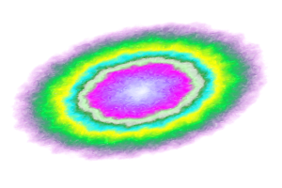


NEXT STEPS
MOVING THE PROJECT FORWARD
Meet with Pavlos to settle on an order of attack and general timeline.
Get the necessary data and create a baseline model.
Continue reading papers in the area to build subject matter knowledge
*not to scale
(…obviously)

Slide 8
SOURCES
[1]: Benavente, Patricio, Protopapas, Pavlos, Pichara, Karim. Automatic Survey-invariant Classification of Variable Stars. The Astrophysical Journal. 2017.
[2]: Castro, Nicolás, Protopapas, Pavlos, Pichara, Karim. Uncertain Classification of Variable Stars: Handling Observational GAPS and Noise. The Astronomical Journal. 2018.
[3]: http://dame.dsf.unina.it/astroinformatics2016/lectures/FForster.pdf

Slide 10

APPENDIX/SUPPORTING SLIDES

Slide 11

CONCLUSIONS
Conclusion: Strong tracklet linking with heliocentric transformation & KD-tree clustering
Also able to do so in just O(n log n) time, a scalable solution!!
Limitations: currently restricted to small (monthly) observation time window
Next Steps: Run the algorithm over all 14m tracklet observations!
Thanks To: The Minor Planet Center for training data, Scott and Brian for project support!

Slide 12
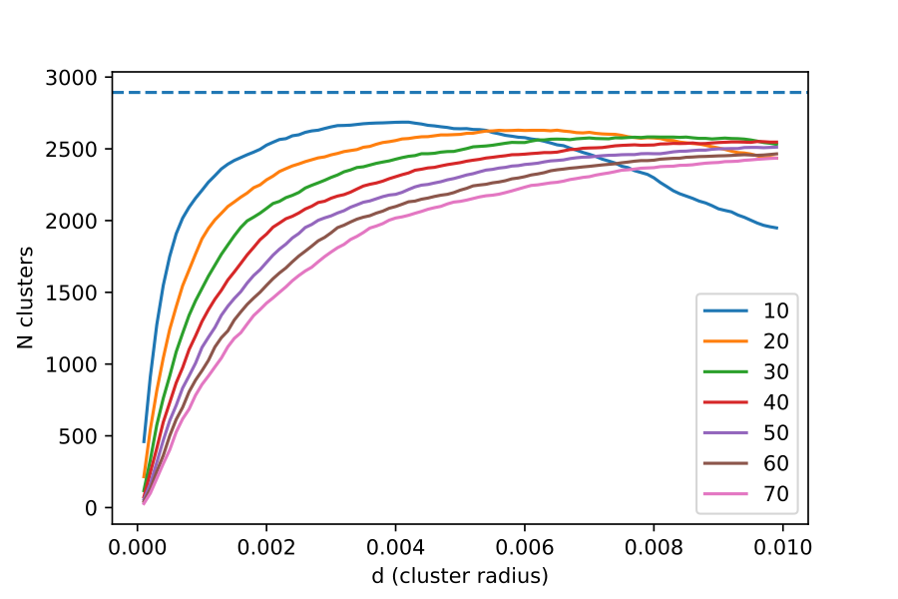
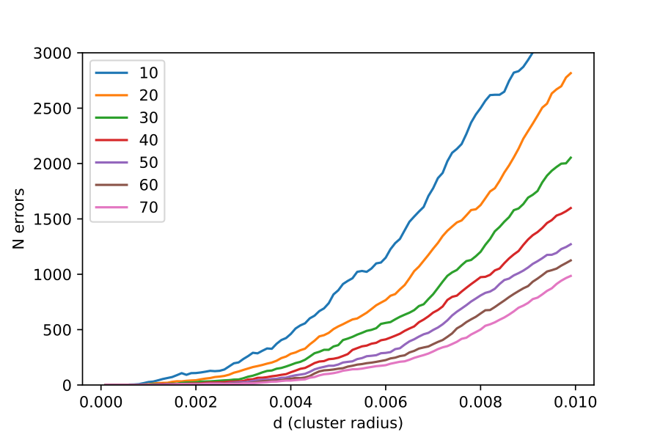
Total clusters detected vs. KD-tree cluster radius (training set)
TUNING PERFORMANCE
OPTIMAL RADIUS:
0.0005-0.0010 radians
Error rate vs. KD-tree cluster radius (training set)
Selected KD-tree clustering for speed (average case log(n))
Also had good results with agglomerative clustering

Slide 13
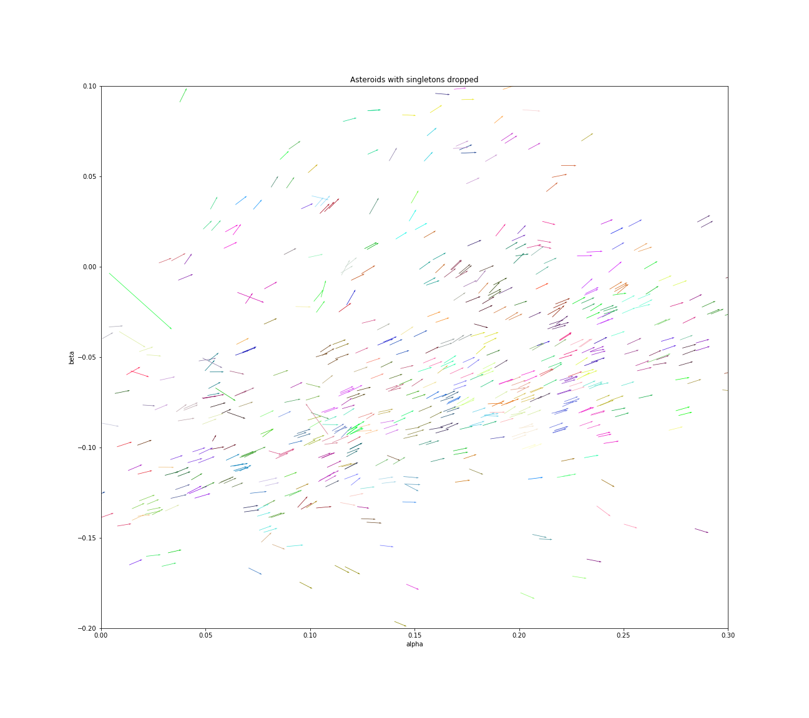
CLUSTERING RESULTS
90% OF ASTEROIDS DETECTED
WITH NEAR-ZERO ERROR!
Identified Asteroids (common colors = a single asteroid)

Slide 14
OUR METHODOLOGY
TUNE CLUSTERING HYPERPARAMETERS OVER KNOWN TRAINING SET (THANKS TO MATT PAYNE, MINOR PLANET CENTER!)
TRAIN CLUSTER RADIUS/WEIGHTING
1.
DIVIDE SKY INTO 300 MONTHLY TIME SLICES, 800 SKY REGIONS
We tune two hyper-parameters:
1) OPTIMAL
CLUSTER RADIUS
2) WEIGHTING OF
VELOCITY VS.
POSITION
2.
ASSERT THE (UNKNOWN)
RADIAL DISTANCE FROM THE SUN
3.
ITERATE OVER RADIAL VELOCITIES, FIT FOR OTHER MOTION PARAMS
4.
CLUSTER BASED ON RESULTING PARAMS: X/Y/Z POSITION, VELOCITY

Slide 15
OUR METHODOLOGY
1.
DIVIDE SKY INTO 300 MONTHLY TIME SLICES, 800 SKY REGIONS
4 of our 6 motion parameters are known, and 1 is relatively constant
Model is linear in the parameters (least squares fit)
2.
ASSERT THE (UNKNOWN)
RADIAL DISTANCE FROM THE SUN
3.
ITERATE OVER RADIAL VELOCITIES, FIT FOR OTHER MOTION PARAMS
4.
CLUSTER BASED ON RESULTING PARAMS: X/Y/Z POSITION, VELOCITY

Slide 16
OUR METHODOLOGY
Dividing into sky regions allows for a more precise clustering
1.
DIVIDE SKY INTO 300 MONTHLY TIME SLICES, 800 SKY REGIONS
2.
ASSERT THE (UNKNOWN)
RADIAL DISTANCE FROM THE SUN

Slide 17


PREPARED BY
MATT HOLMAN
PAUL BLANKLEY
RYAN JANSSEN
WITH MATT PAYNE,
Minor Planet Center
PREPARED BY
MATT HOLMAN
PAUL BLANKLEY
RYAN JANSSEN
WITH MATT PAYNE,
Minor Planet Center
CS182 – ARTIFICIAL INTELLIGENCE
30 NOVEMBER 2017

Slide 18
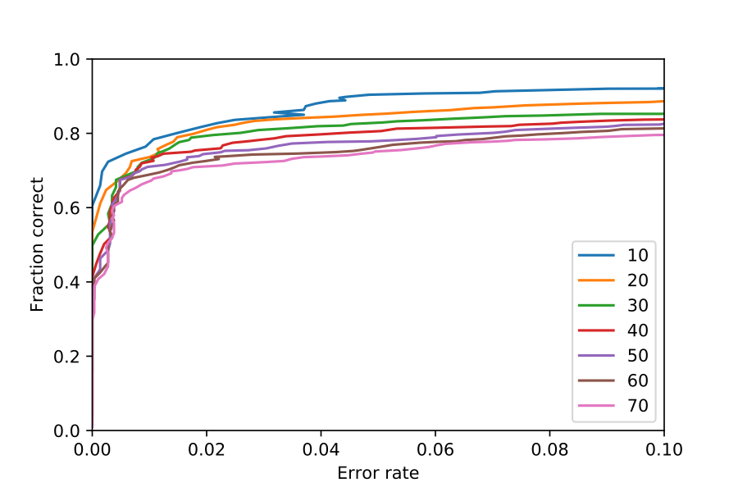
Training AUC

Slide 19
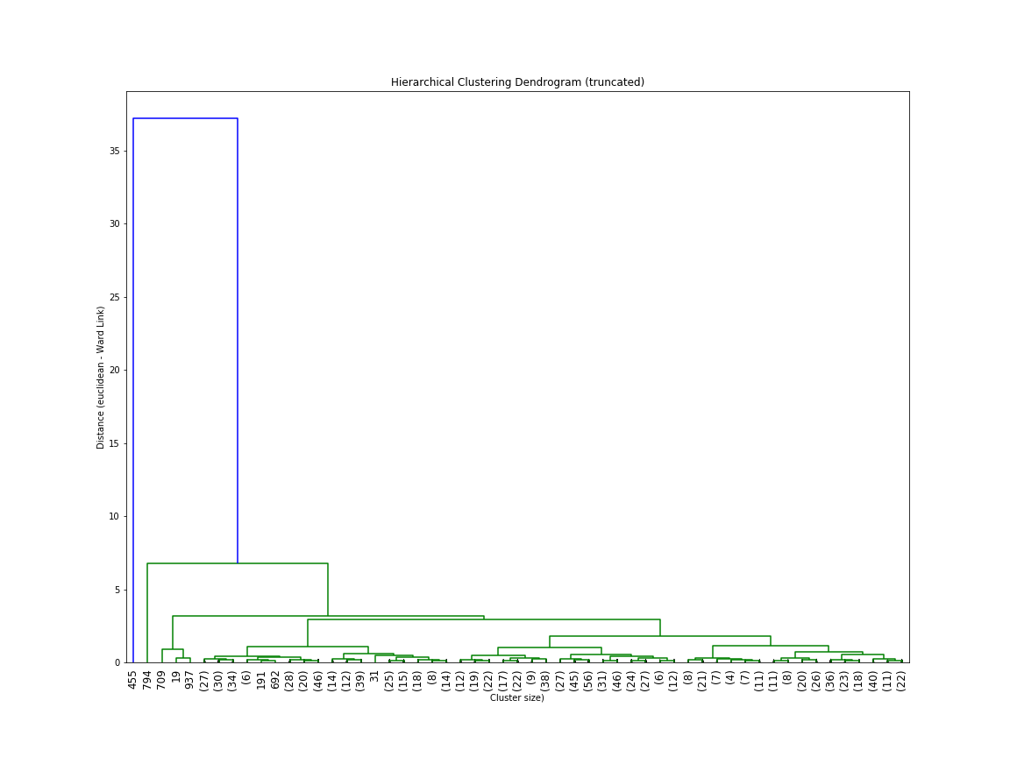
Agglomerative Clustering Dendogram (Truncated)

Slide 20
Total clusters detected vs. KD-tree cluster radius (training set)

Slide 21
Error rate vs. KD-tree cluster radius (training set)

